Slide 1
Mapping vulnerability
MDGs and Earth observations in disaster epidemiology
2nd GEOSS Science and Technology Stakeholder Workshop
Bonn, Germany, August 28-31, 2012
Peter Heudtlass
Debarati Guha-Sapir
Centre for Research on the Epidemiology of Disasters (CRED), Brussels
CRED’s conflict program gratefully receives funding from the Canadian International Development Agency (CIDA) and the UK Department for International Development (DFID); the natural disaster program from the United States Agency for International Development (USAID).
Notes:
Earth observations we are dealing with: satellite imagery, geo-referenced data, GIS – but: most data has to be collected “manually” on the ground

Slide 2


About CRED
Research on health impact of disasters for about 40yrs
Current projects
Mortality rates and causes in natural disasters, conflict, refugee and IDP populations
Epidemics in instable settings (malaria, cholera, diphtheria, measles)
Management of acute malnutrition
Long-term impact of reoccurring natural disasters on levels of malnutrition
Community Case Management of pneumonia and diarrhea in instable settings
Impact and cost-effectiveness of humanitarian interventions
…
Notes:
The Centre undertakes research and provides an evidence base on the burden of disease and health issues arising from disasters and conflicts to improve needs-based preparedness and responses to humanitarian emergencies.

Slide 3
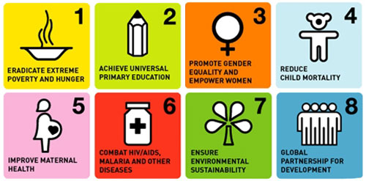
MDGs and disaster epidemiology
… 4 out of 8 goals are health-related
(hunger, child mortality, maternal health and infectious diseases)
… least progress in populations affected and displaced by conflict and disasters
(an estimated 700m people per year!)

Slide 4
CREDs research on MDGs
What are the main risk factors and conditions?
Who and where are the most vulnerable populations?
Which interventions* do work? (cost-effectiveness)
*prevention and relief
Notes:
What are the risk-factors/characteristics of people who die in disasters? Micro: age/sex/socio-economic status macro: country, livelihood, etc.
What are the conditions, that is for instance causes of mortality and morbidity pattern -> example South Sudan and measles -> mortality causes are different in populations under stress
Answering these question is crucial for policy making, priority setting, targeting and designing of prevention and relief policies.
Macro-level: what are characteristics of countries where people die in disasters? In civil conflicts?
This presentation will focus on the “where” – to our mind a potential field for working with earth observations
vital registration systems (registers of births and deaths); large-scale health surveys (DHS, MICS); health information systems

Slide 5
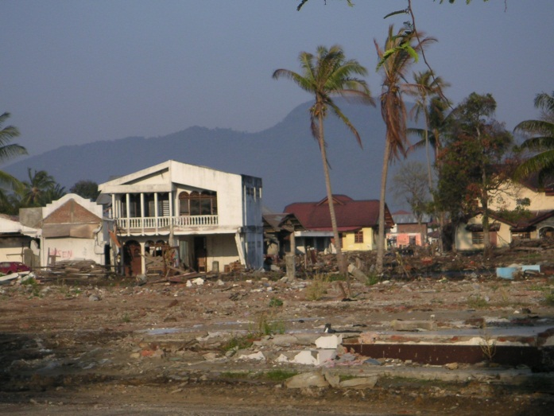
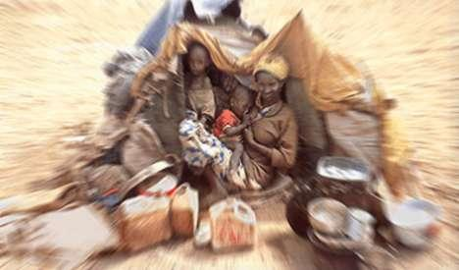
CRED’s geo-referenced databases
EMDAT
The International Disaster Database
- natural disasters -
www.emdat.be
CEDAT
The Complex Emergency Database
- (civil) conflicts -
www.cedat.be

Slide 6
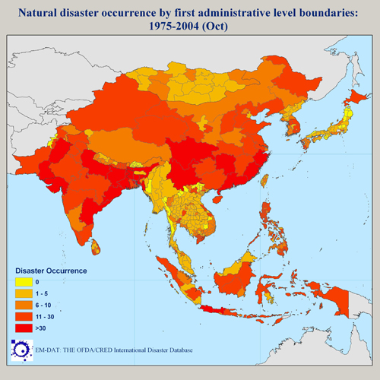
EMDAT
Human and economic impact of around 20,000 disaster events
1900 - today
Cross-checked data, mainly from news agencies and insurance companies
country level data
Work in progress: disaggregation at state and district level

Slide 7
CEDAT
Global survey repository with more than 3,000 health surveys from complex emergencies
2000 - today
small-scale surveys (typically district level)
Indicators on mortality (retrospective), morbidity, malnutrition, access to health services, access to water & sanitation
Data collected by humanitarian agencies (mainly UN and INGOs)
Sub-national, geo-referenced data
Notes:
CEDAT difficulty: NGOs have to be convinced that data sharing makes sense for them! (added value)
→ We need to provide them with outputs,

Slide 8
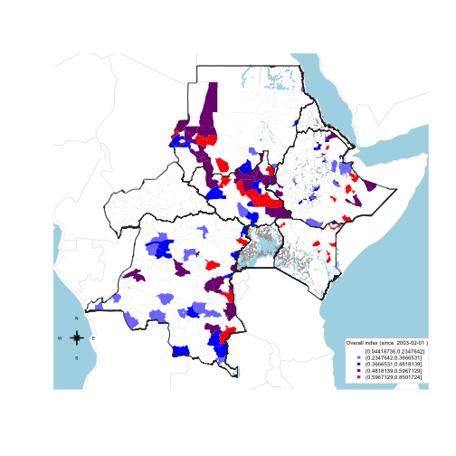
Conflict & Health – hotspot analysis
Vulnerability index by district based on:
Vaccination coverage
Malnutrition
Mortality
Parasite prevalence (malaria/dengue)
Recent conflict events
Work in progress!
Notes:
Product for policy-makers
How can our system be part of the system of systems?
Involves considerable research on a reasonable choice of fuzzy logic functions and weights
Creating such an index is not easy, just combining different data sources is not enough if one wants to provide actionable policy advice.

Slide 9
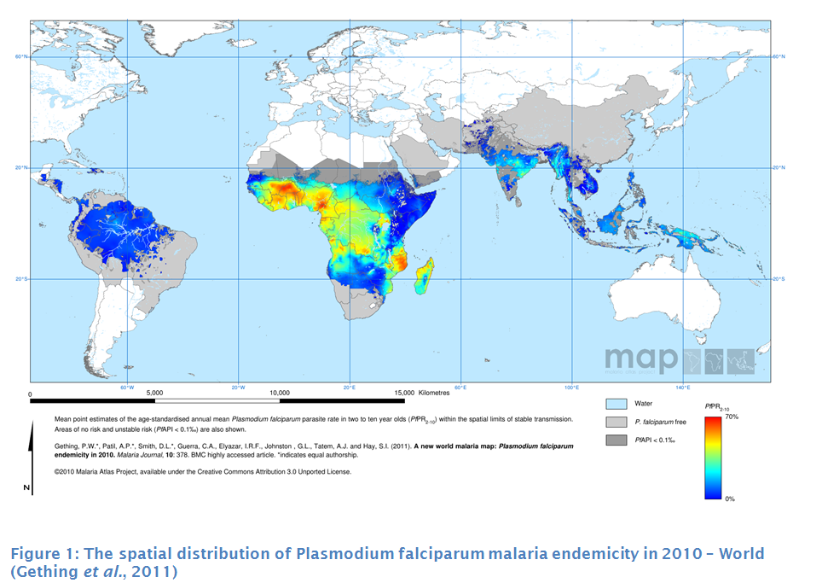
Challenges (1): data availability
More and better spatial data needed:
endemicity of parasites (vectors) and diseases?
Notes:
For instance cholera (EU2HEAVEN)

Slide 10
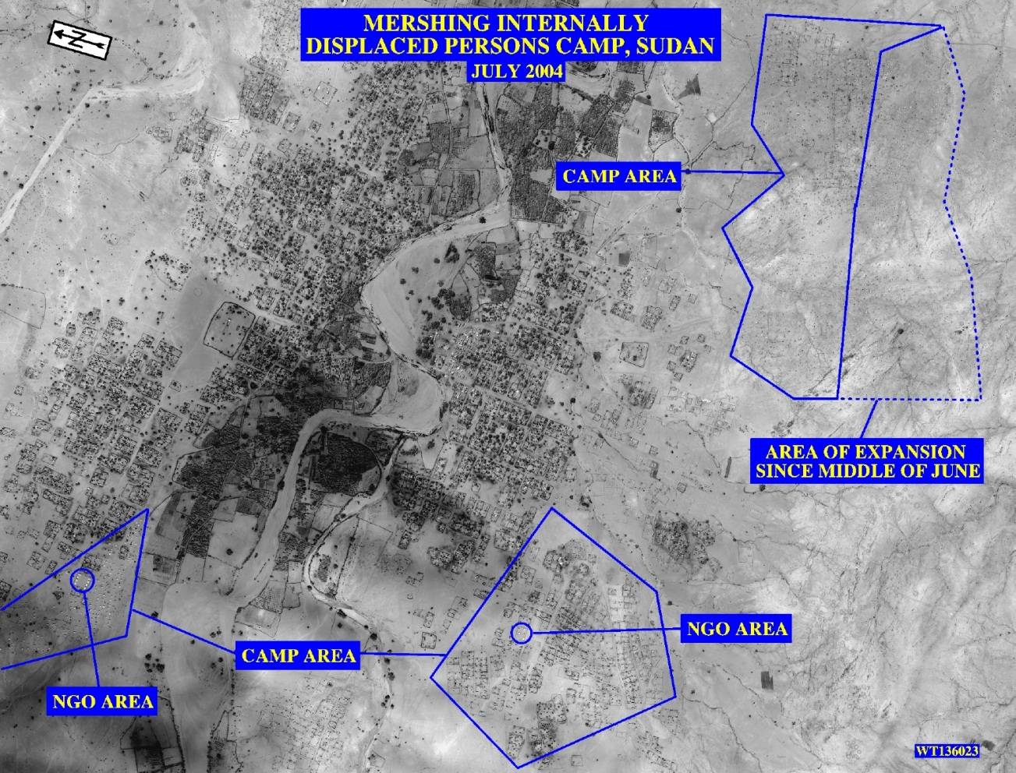
Challenges (2): health data collection
Sampling of displaced populations
Producing sampling frames from satellite imagery -> recent research conducted by Chris Grundy (LSHTM) and MSF
IDP camp in Sudan, satellite picture (source: globalsecurity.org)

Slide 11
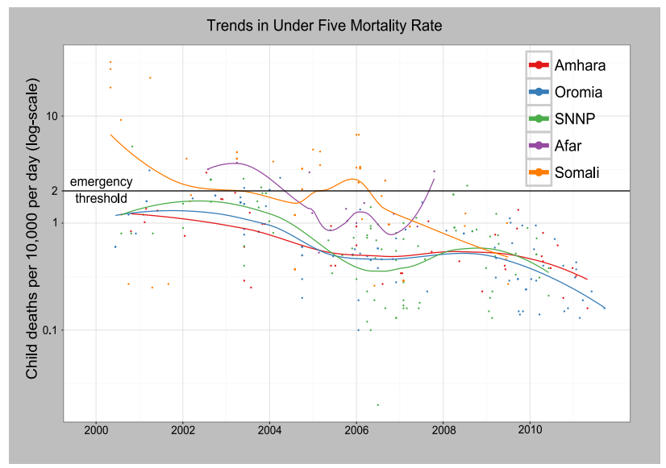
Challenge (3): methods
Comparative and trend analysis with non-systematic samples in space and time from multiple sources
Bayesian Networks?
Trends in Under Five Mortality in different Ethiopian provinces (source: CEDAT)
Notes:
How can these pieces of information be integrated into the monitoring of the national progress towards MDGs?

Slide 12
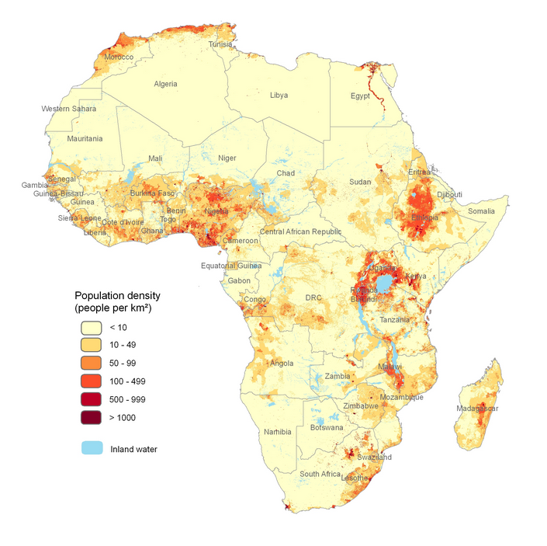
Challenge (4): denominators
Need for better population figures
estimating populations using nighttime satellite imagery? (for instance AfriPop project)
Satellite imagery from high risk populations? (refugees, IDPs, conflict zones)
Population density in Africa (source: AfriPop.org)
Notes:
Afripop: disadvantage: yearly figures, depends on outdated census data

Slide 13
Thank you! cred.be emdat.be cedat.be

